Slide 1
WQD7007 Big Data Management
Big Data Tools
HBase

Slide 2
HBase
WQD7007 Big Data Management
An open source NoSQL database that provides random and real-time read/write (CRUD operation) access to those large datasets that runs on top of HDFS.
HBase scales linearly to handle huge data sets with billions of rows and millions of columns, and it easily combines data sources that use a wide variety of different structures and schemas.
making it a great choice to store multi-structured or sparse data.
Notes:
CRUD – create, read, update, delete

Slide 3
HBase
WQD7007 Big Data Management
These following characteristics make HBase a great choice for storing semi-structured data like log data and then providing that data very quickly to users or applications integrated with HBase.
Linear scaling of Hbase:
Require all tables to have a primary key.
The key space is divided into sequential blocks that are then allotted to a region.
RegionServers own one or more regions, so the load is spread uniformly across the cluster.
Notes:
Linear scaling of Hbase extra: If the keys within a region are frequently accessed, HBase can further subdivide the region by splitting it automatically, so that manual data sharding is not necessary.

Slide 4
HBase
WQD7007 Big Data Management
Characteristics | Benefit
Fault tolerant | Replication across the data center Atomic and strongly consistent row-level operations High availability through automatic failover Automatic sharding and load balancings of tables
Fast | Near real time lookups In-memory caching via block cache and bloom filters Server side processing via filters and co-processors
Usable | Data model accommodates wide range of use cases Metrics exports via File and Ganglia plugins Easy Java API as well as Thrift and REST gateway APIs

Slide 5
HBase
WQD7007 Big Data Management
Enterprises use Apache HBase’s low latency storage for scenarios that require real-time analysis and tabular data for end user applications.
Example 1: One company that provides web security services maintains a system accepting billions of event traces and activity logs from its customer’ desktops every day.
The company’s programmers can tightly integrate their security solutions with HBase (to assure that the protection they provide keeps pace with real-time changes in the threat landscape.)
Notes:
SLA – service-level agreement : e.g. refer to guaranteed level of availability in web host.

Slide 6
HBase
WQD7007 Big Data Management
Example 2: One company provides stock market ticker plant data that its users query more than thirty thousand times per second, with an SLA of only a few milliseconds.
Apache HBase provides that super low-latency access over an enormous, rapidly changing data store.
Notes:
SLA – service-level agreement : e.g. refer to guaranteed level of availability in web host.

Slide 7
HBase
WQD7007 Big Data Management
Apache HBase provides high availability in several ways:
Highly available cluster topology information through production deployments with multiple HMaster and ZooKeeper instances
Data distribution across many nodes means that loss of a single node only affects data stored on that node

Slide 8
HBase
WQD7007 Big Data Management
Apache HBase provides high availability in several ways:
HBase HA allows data storage, ensuring that loss of a single node does not result in loss of data availability
HFile format stores data directly in HDFS. HFile can be read or written to by Apache Hive, Apache Pig, MapReduce, and Apache Tez, permitting deep analytics on HBase without data movement

Slide 9
Online reference
https://acadgild.com/blog/apache-hbase-beginners-guide/

Slide 10
Version command
hbase(main):001:0> version

Slide 11
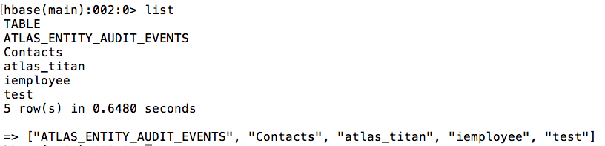
list command
hbase(main):002:0> list

Slide 12
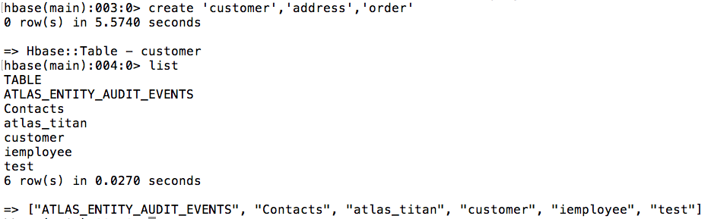
Create table
hbase(main):003:0> create 'customer','address','order’
hbase(main):004:0> list

Slide 13
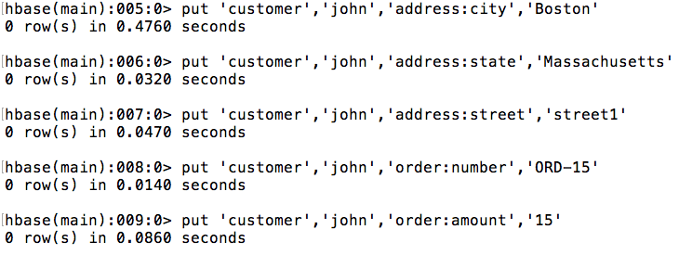
Insert entry
hbase(main):026:0> put 'customer','john','address:city','Boston’
customer is the table name
John is the row key
address is the column family
Boston is its value.

Slide 14
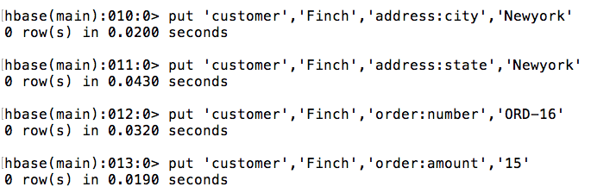
Put another record

Slide 15
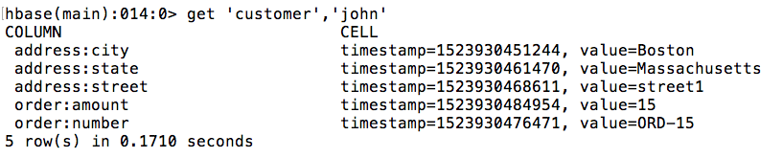
Get record
hbase(main):026:0> Get ‘customer’, ‘john’

Slide 16
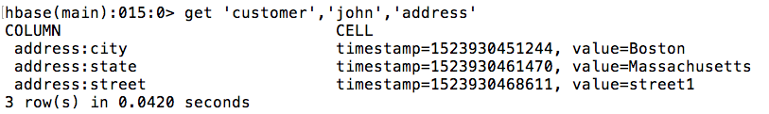
Get record (2)
Using get command to retrieve the address of john
hbase(main):044:0> get 'customer','john','address'

Slide 17

Get record (3)
Using get command to retrieve city of john
hbase(main):045:0> get 'customer','john','address:city'

Slide 18
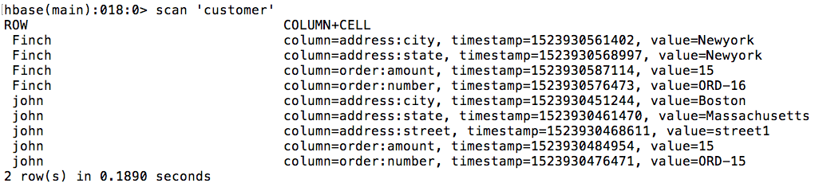
Scan record
hbase(main):017:0> scan customer

Slide 19
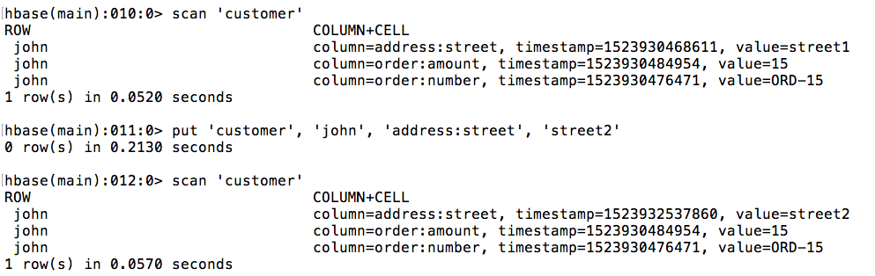
Update record
hbase(main):011:0>
put 'customer', 'john', 'address:street', 'street2'

Slide 20
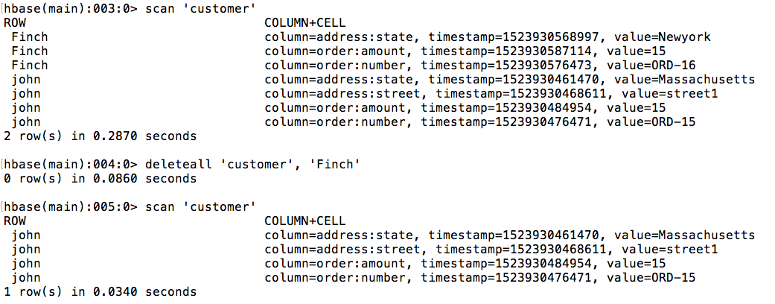
Delete entire record
hbase(main):019:0> deleteall 'customer','Finch'

Slide 21
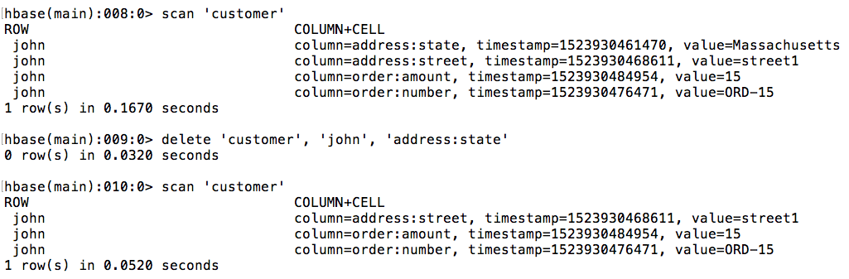
Delete specific column
hbase(main):046:0> delete 'customer',john,'address:state'

Slide 22
Other commands
count ‘customer’
disable ‘customer’
drop ‘customer’

